Slide 1
Characteristics of computer operating systems
SECURED OPERATING SYSTEM– IT2030

Slide 2
INTRODUCTION
Section 1: Features of Linux operating system
Section 2: Features of Windows operating system.
Section 3: Features of Mac operating system.
Section 4: Features of Android mobile operating system.
Questions

Slide 3
Security features in Linux operating system.
2. Provide a stable,portable,reliable,safe and
well-behaved environment
Share resources among users,fairly,efficiently and safety
Manage memory,processor and file.
SECTION 1-Linux operating system

Slide 4





1. SECURITY FEATURES IN LINUX OPERATING SYSTEM
User permissions and privileged management
Open-source security modules
File system security
SECURITY IN LINUX
Package management and updates
Network security

Slide 5
USER PERMISSION AND PRIVILLEGE MANAGEMENT
Three types of users are defined.
User accounts are further categorized into three types.
USER PERMISSIONS
GROUP
USER
PUBLIC
ROOT USER
REGULAR USER
SERVICE USER

Slide 6
FILE SYSTEM SECURITY
Commands such as ‘chown’ and ‘chmod’ used to modify the privileges for files or directories.
Two methods of changing privileges.
Absolute method
Symbolic method
0 indicates no permission.
1 indicates execute permission.
2 indicates write permission.
4 indicates read permission.
Chmod 774 file.txt
Absolute method
Octal values are given to specify the privileges.
Symbolic method
Privileges are specified by using characters r,w,e
chmod a+rw file.txt
read,write and execution permissions are given to file.txt

Slide 7
NETWORK SECURITY
NETWORK SECURITY
TCP WRAPPERS
VPN
FIREWALL MANAGEMENT
NETWORK SECURITY MANAGEMENT Ex: ssh
SECURITY AUDITING AND LOGGING Ex: auditd

Slide 8
2. PROVIDE A STABEL, PORTABLE, RELIABLE, SAFE, WELL-BEHAVED ENVIRONMENT
STABILITY
Achieved by both kernel and software stability
Software package management supports stability by reducing conflicts which leads to system unreliability.
Modular design of kernel
STABILITY
Software Package management
Robust file system
Community code review

Slide 9
PORTABILITY
Linux operates on various devices such as servers, personal computers, mobile devices and embedded system due to portability.
For instance, system libraries in Linux can operates on other devices
Dynamic linking of programs libraries
PORTABILITY
Abstraction layers
POSIX compliances
Cross platform development tools

Slide 10
RELIABILITY
Open source development of Linux offers more reliability than other operating systems.
Following are the techniques used linux operating system to ensure reliability.
Data encryption tools
RELIABILTIY
Defined privileges for users and groups.
Backup and recovery
Logs of user logins

Slide 11
SAFETY
Various tools and techniques in Linux operating system to ensure safety of the devices.
Access control systems
SAFETY
Service updates
Firewall functions
Event logging management

Slide 12
3. SHARE RESOURCES AMONG USERS FAIRLY, EFFICIENTLY AND SAFELY
USER AND GROUP MANAGEMENT
SHARING RESOURCES
SAFETY

Slide 13
USER AND GROUP MANAGEMENT
Users are grouped in Linux, each assigned defined permissions, facilitating efficient user management.
Administrators possess the ability to enforce access controls and allocate resources based on user groups.
Fine-grained control is provided, allowing administrators to set constraints on various resources such as CPU time, file size, and memory usage for specific users or groups.

Slide 14
SHARING RESOURCES
Various methods and techniques used to ensure proper management of computer resources
Following are the some of the techniques.
MANAGING DISK I/O REQUESTS
Algorithm called CFQ used to manage disk I/O
CFQ – Complete fair queuing.
CPU SHEDULING
Algorithm called CFs used to manage CPU scheduling.
CFS – Complete fair scheduling.

Slide 15
SAFETY
User permissions form a fundamental part of Linux security, controlling access to resources based on user roles.
SELinux and AppArmor add an additional layer of security by enforcing access policies, preventing unauthorized actions and breaches.

Slide 16
4. MANAGE MEMORY, PROCESSOR ANF FILE IN LINUX OPERATING SYSTEM
MEMORY MANAGEMET
Virtual memory primer
Memory
pages
Compaction
Reclaim
Idle page
tracking
Kernel same-page merging
Contigous memory allocation

Slide 17
SECTION 2- Windows operating system
Level of security windows provides.
2. Manage memory, processor, file.
Support many devices simultaneously.
Hide implementation details.

Slide 18




Level of security windows provides.​
User Account Control
Windows Security
Firewall and
network security
Security policies
Windows Defender

Slide 19
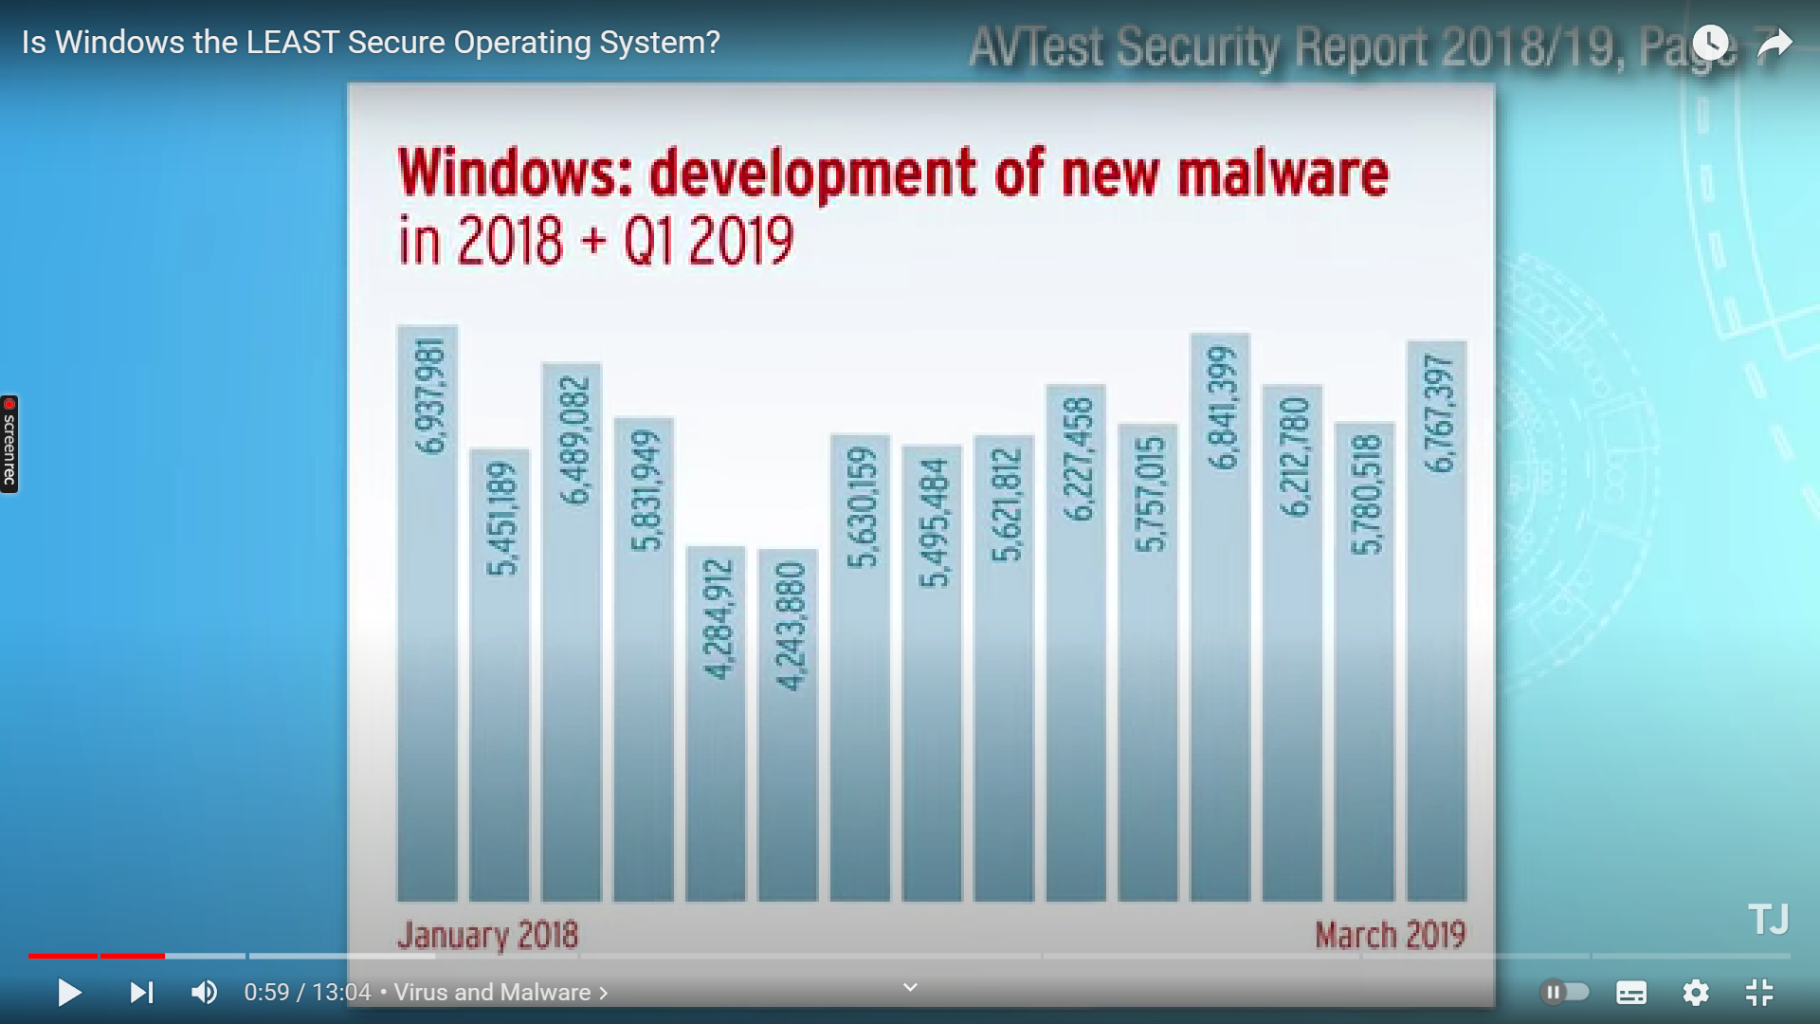
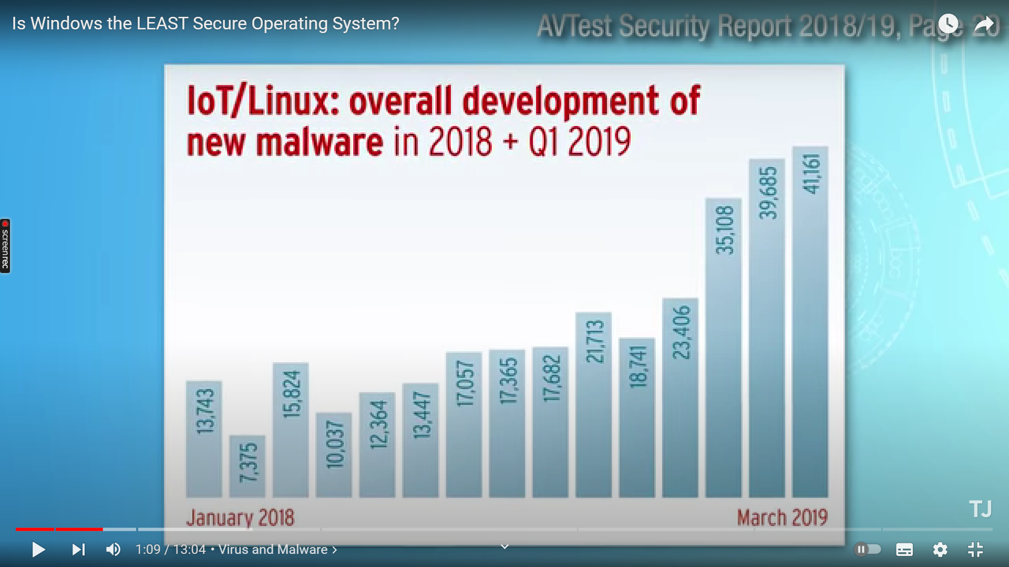
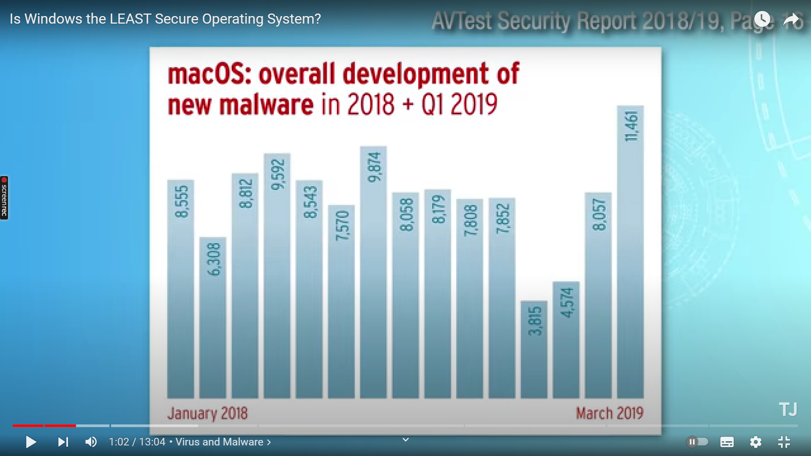
Is windows the least secure operating system?
Malware detected in a month
4Million to 7 Million
10 thousand to 40 thousand
3 thousand to 11 thousand

Slide 20

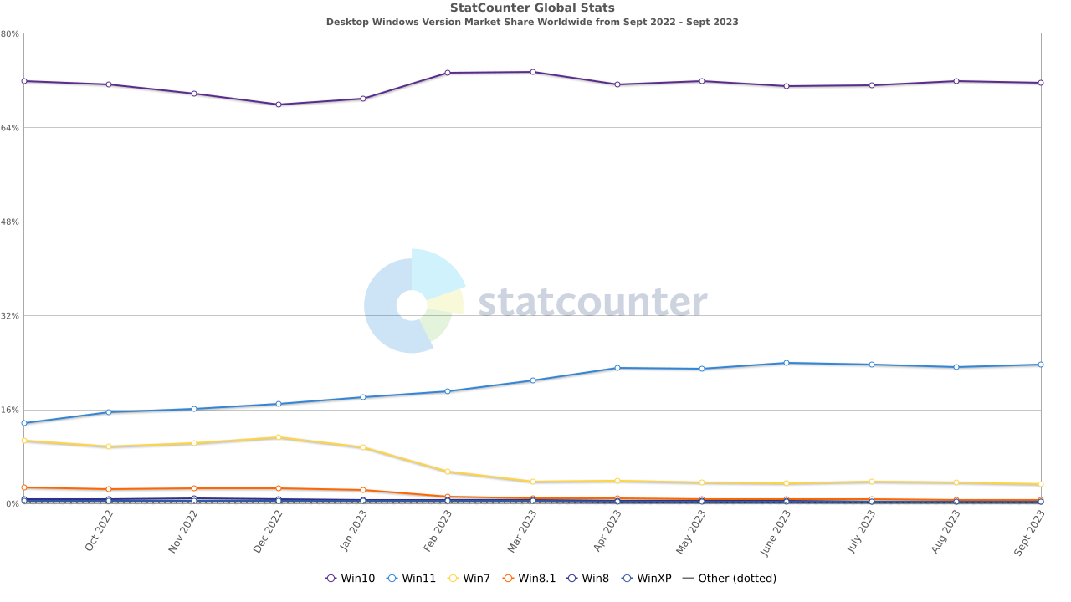

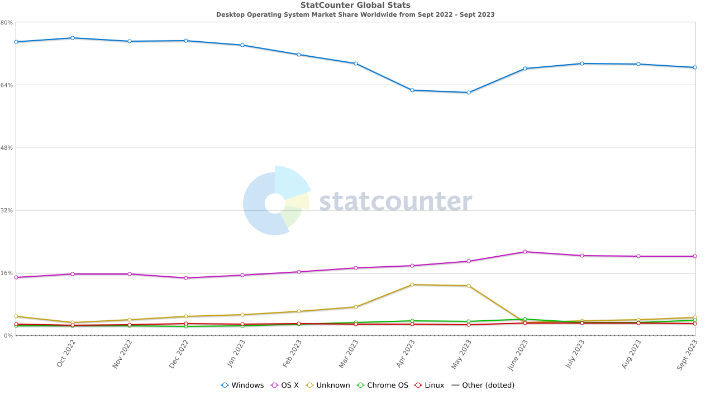
Reason
According to this data Operating system market share details.
Windows – 76%
MacOS- 19%
Linux-1.6%
According to this data windows OS various version usage till 2023 sept
Windows 10 – 70%
Windows 11- 19%
Windows xp- 0.5%
Windows 7 – 10%

Slide 21
2. Manage memory, process, and files.
Windows Management
Memory management
Process management
File management
Swapping
Segmentation
Process Scheduling
Types of file

Slide 22









3. Support many devices simultaneously.
Personal computers-windows 10/11
Universal plug and play-UPnP
Servers-windows server 2019
Unified user experience
Devices and versions
Advantages
Input Devices-windows vista/XP/7/10/11
Cross platform compatibility
Mobile devices-windows mobile
Enhanced
productivity
Printers and scanners-windows 8.1/7/10

Slide 23

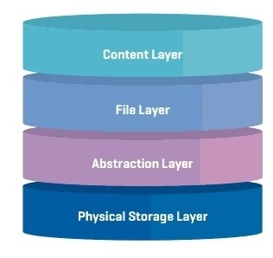
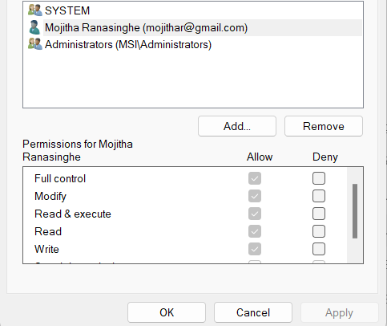
4. Hide the implementation details
Why?
Prevent unauthorized access and attacks.
Keep user experience and stability.
How?
Use abstract layer.
Give user's to privileges and access control.

Slide 24
SECTION 4- Android mobile operating system
The level of security it provides.
2. Hide the implementation details.
3. Manage memory, processor, file etc
4. Resolve conflict in resource demand.

Slide 25
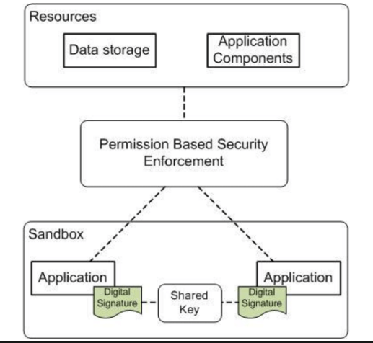
The level of security it provides

Slide 26
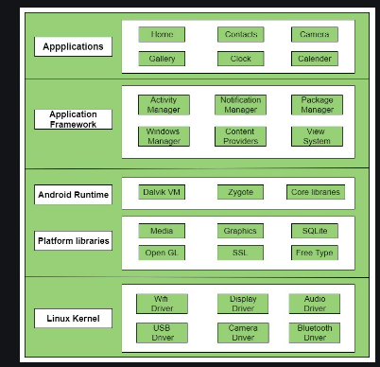
2.Hide the implementation details.

Slide 27
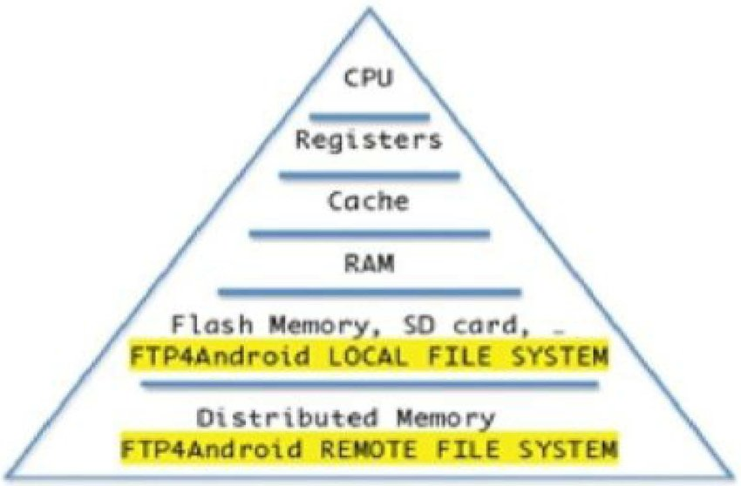
3.Manage memory, processor, file etc.

Slide 28

4.Resolve conflict in resource demand.

Slide 29


Slide 30
SECTION 3- MAC operating system
Support many devices simultaneously.
Provide a stable, portable, reliable, safe, and well-behaved environment.
Management of memory, and process.
The level of the security macOS provides.

Slide 31
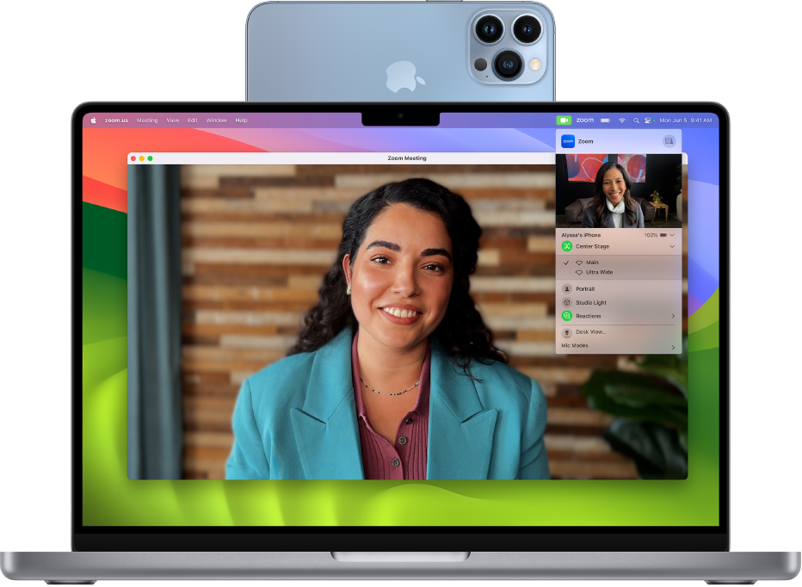
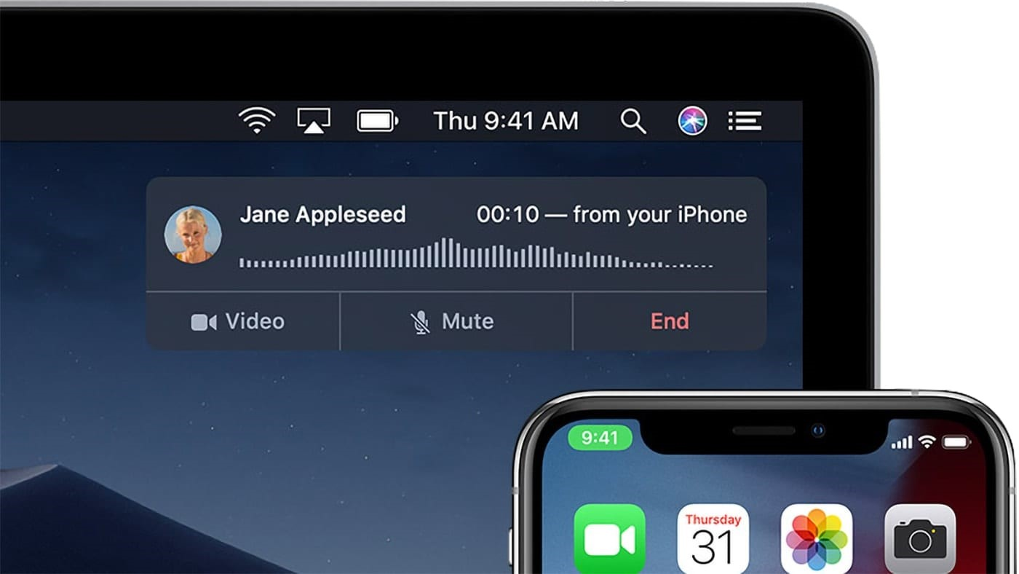
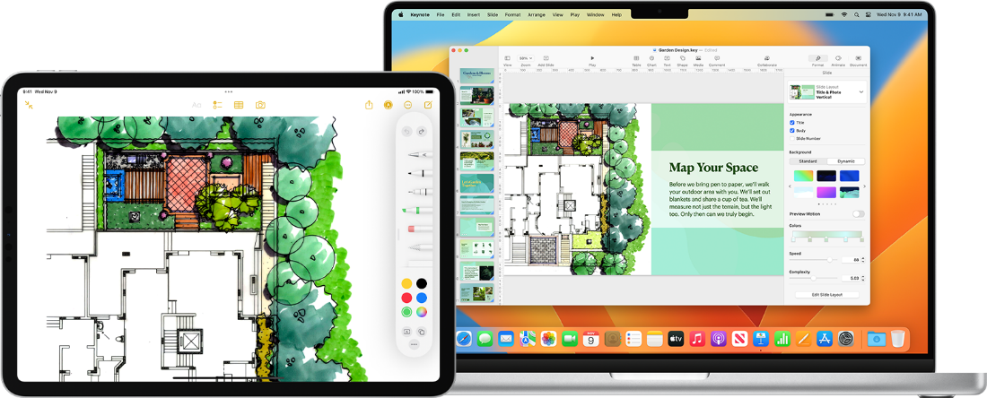
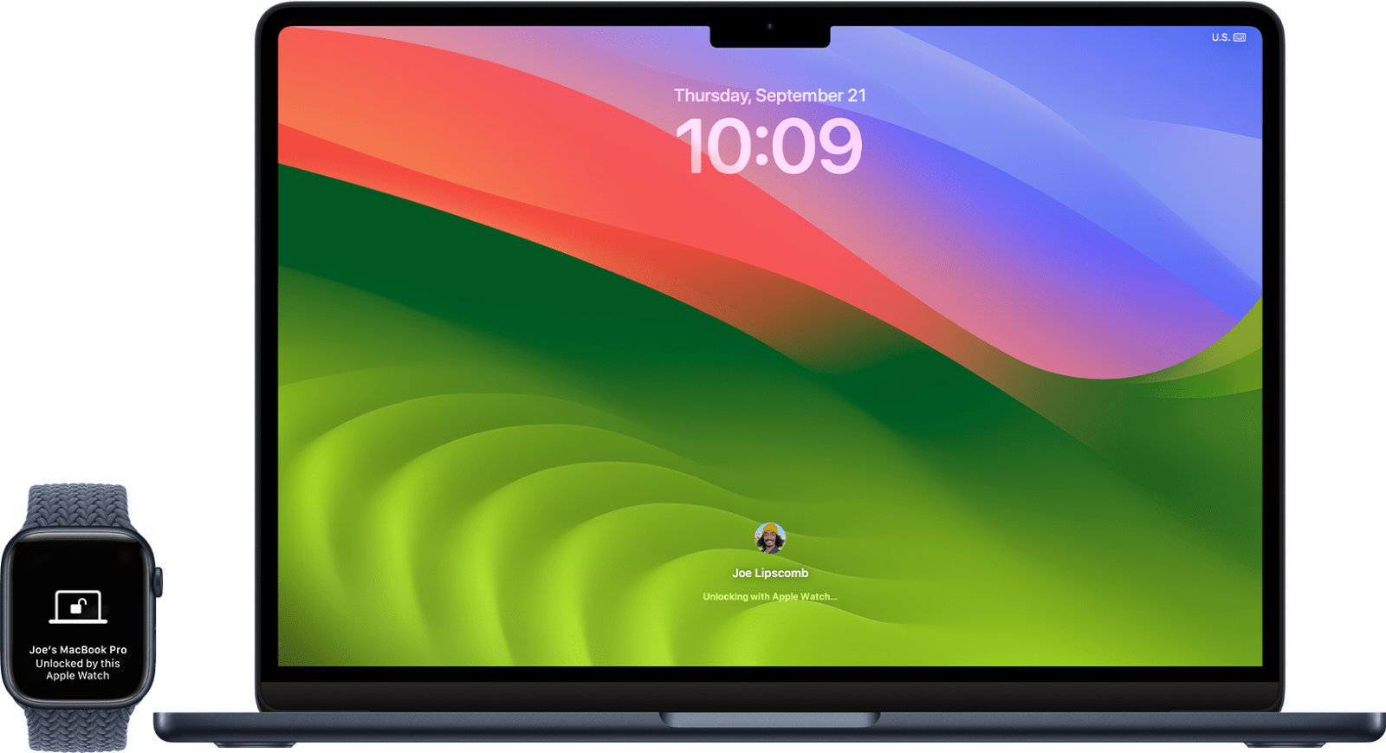
Support many devices simultaneously
The iPhone can wirelessly connect to a Mac as a web camera.
All photos and files can be accessed from any device.
The user can copy a file on one device and paste it on another device.
Allows a Mac keyboard and trackpad/mouse to operate a nearby iPad.
If we receive a call on our iPhone, we can answer the call from our Mac.
The computer can be unlocked using the Apple Watch.

Slide 32
Provide a stable, portable, reliable, safe, and well-behaved environment
Install anti-virus and anti-malware
Gatekeeper
XProtect
FileVault
Software update
System monitoring
Stability
Safety​

Slide 33
Portability
Cloud services like iCloud, Dropbox, or Google Drive
Airdrop allows us to share files
Siri allows us to perform tasks hands-free using their voice

Slide 34
Reliability
Choose reliable hardware and peripherals
Test and troubleshoot hardware components
Apple ID use to access all Apple services

Slide 35
Well behaved environment
clean up function
Spotlight Search
The Dock
Focus Mode
Split View

Slide 36
The level of the security macOS provides
The Apple M1 chip
The Find My app
Activation Lock

Slide 37
Conclusion
Conclusion

Slide 38

ANY QUESTIONS?

